Slide 1

Small Area Estimation
Unit level models
Training prepared for Summer University 2022
Paul Corral (pcorralrodas@worldbank.org)

Slide 2
Material available at: https://github.com/pcorralrodas/wb_sae_training
Training prepared for Summer University 2022
Paul Corral (pcorralrodas@worldbank.org)

Slide 3
Main references for unit-level small area estimation
Elbers, C., Lanjouw, J. O. [Jean O], & Lanjouw, P. (2003). Micro–level estimation of poverty and inequality. Econometrica, 71 (1), 355–364.
Molina, I., & Rao, J. (2010). Small area estimation of poverty indicators. Canadian Journal of Statistics, 38 (3), 369–385.
Marhuenda, Y., Molina, I., Morales, D., & Rao, J. (2017). Poverty mapping in small areas under a twofold nested error regression model. Journal of the Royal Statistical Society: Series A (Statistics in Society), 180 (4), 1111–1136.
To learn about the updates
Corral, P., Molina, I., & Nguyen, M. C. (2020). Pull your small area estimates up by the bootstraps. Journal of Statistical Computation and Simulation, 91(16), 3304-3357.
Corral, P., Himelein, K., McGee, K., & Molina, I., (2021). A Map of the Poor or a Poor Map? Mathematics 9, no. 21: 2780. https://doi.org/10.3390/math9212780
Corral. P., Molina, I., Cojocaru, A., & Segovia, S. (2022). Guidelines to Small Area Estimation for Poverty Mapping.

Slide 4
Introduction
Monetary poverty (FGT0) is a non-linear parameter
Initial work at the WB was done by Hentschel, Lanjouw, Lanjouw, and Poggi (1998) but ignored random location effects – we’ll se later why that matters
The welfare distribution is simulated in the census data based on parameters estimated using household survey data which has detailed information on welfare
This yields a welfare value for every single household in the census
Simulating the full welfare distribution allows for estimates beyond just poverty and mean welfare for a given area.
Elbers, Lanjouw and Lanjouw (2003) improved on the method
It was the go-to method for poverty maps done by the World Bank or with the World Bank’s assistance until ~2015
The latest Stata sae package can be obtained from: https://github.com/pcorralrodas/SAE-Stata-Package

Slide 5
Criticism and the publication from Molina and Rao’s EB method led the institution to update methods
In a review of World Bank research, the ELL method was scrutinized by Banerjee et al. (2008)
The reviewers were concerned that the method may not accurately present the true precision of the method’s estimates – among other things
Haslett (2010) recommended adjusting the fitting method described in ELL (2002)
Indicated it leads to an asymmetric variance-covariance matrix
Molina and Rao (2010) showed in simulation studies that ELL is noisy and underperforms under the model’s assumptions
Showed that EB methods are considerably superior and yield substantially less noisy estimates
A shift to Molina and Rao’s EB methods by the World Bank and its toolkit is detailed in Corral, Molina and Nguyen (2020)

Slide 6
The Game Plan
You have a set of do-files in the shared repository
Please make sure you’ve downloaded that repo: https://github.com/pcorralrodas/wb_sae_training
Also make sure you have the sae package: https://github.com/pcorralrodas/SAE-Stata-Package
Also make sure you have groupfunction and sp_groupfunction: https://github.com/pcorralrodas/groupfunction and https://github.com/pcorralrodas/sp_groupfunction
We will discuss a topic briefly and jump to the Stata do files to see for ourselves how things work and the assumptions underlying the methods
This GitHub repo for the training will be a living repo. I will update it as deemed necessary.
If you want to contribute, please let me know and you can create a branch and we add stuff. I will add you to the list of collaborators.

Slide 7
What is Necessary in order to do a Unit-level Poverty Map?
Household survey and Census must have variables in common between them
Questions should be defined in a similar manner in both data sources
Variables should have similar distributions
Common variables should be sufficiently correlated with the welfare measure of interest (income or consumption)
Additionally, we need a location variable in order to link the census and survey at that level

Slide 8
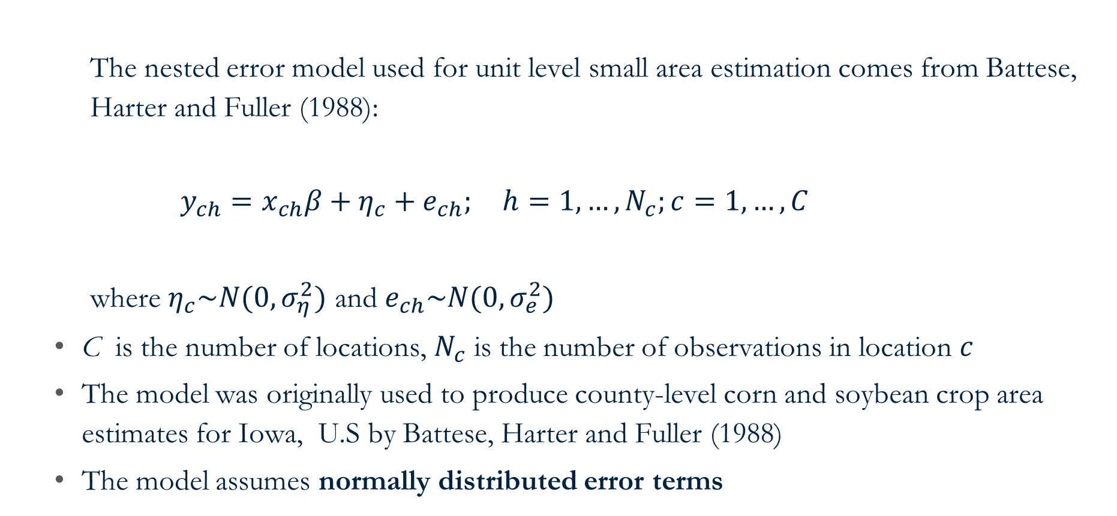
The assumed model used for unit-level SAE
The nested error model used for unit level small area estimation comes from Battese, Harter and Fuller (1988):
$y_{ch}=x_{ch}β+η_{c}+e_{ch}; h=1,…,N_{c};c=1,…,C$
where $η_{c}\sim N(0,σ_{η}^{2})$ and $e_{ch}\sim N(0,σ_{e}^{2})$
C is the number of locations, $N_{c}$ is the number of observations in location $c$
The model was originally used to produce county-level corn and soybean crop area estimates for Iowa, U.S by Battese, Harter and Fuller (1988)
The model assumes normally distributed error terms

Slide 9
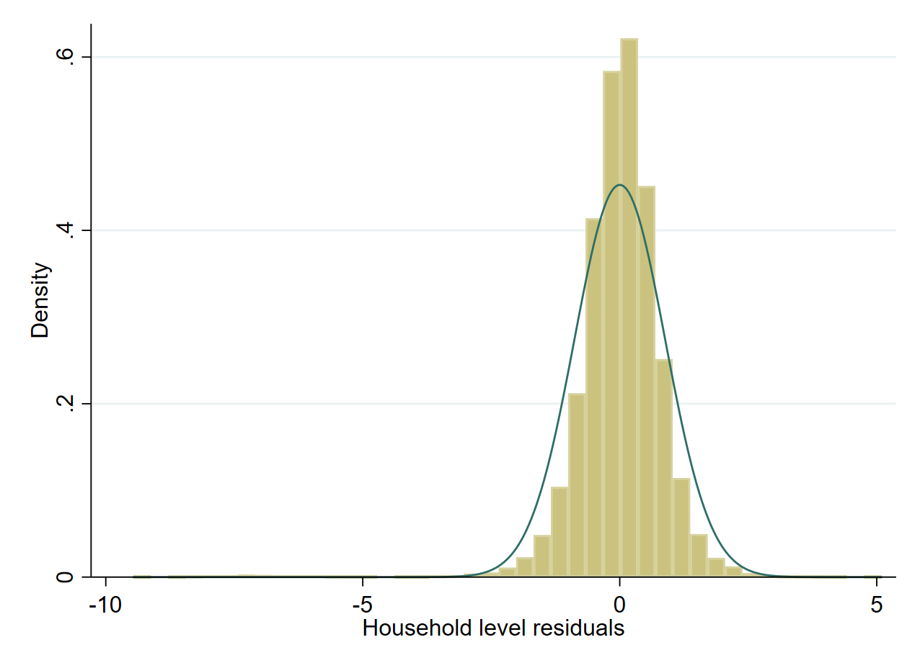
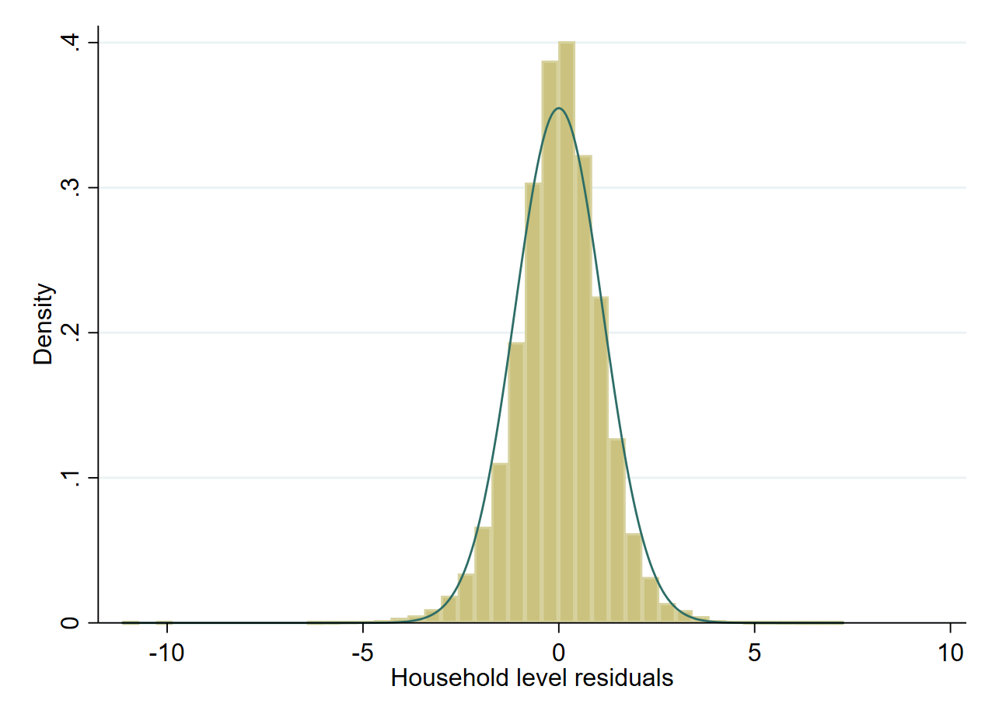
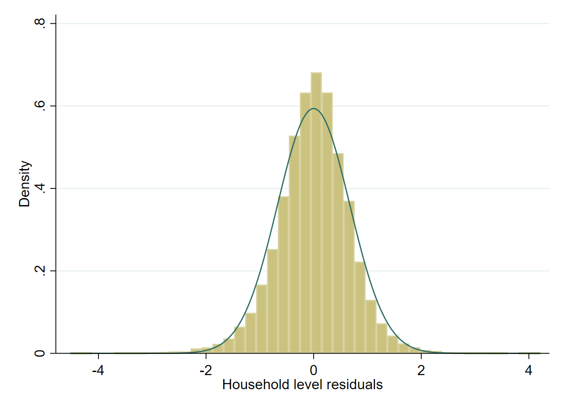
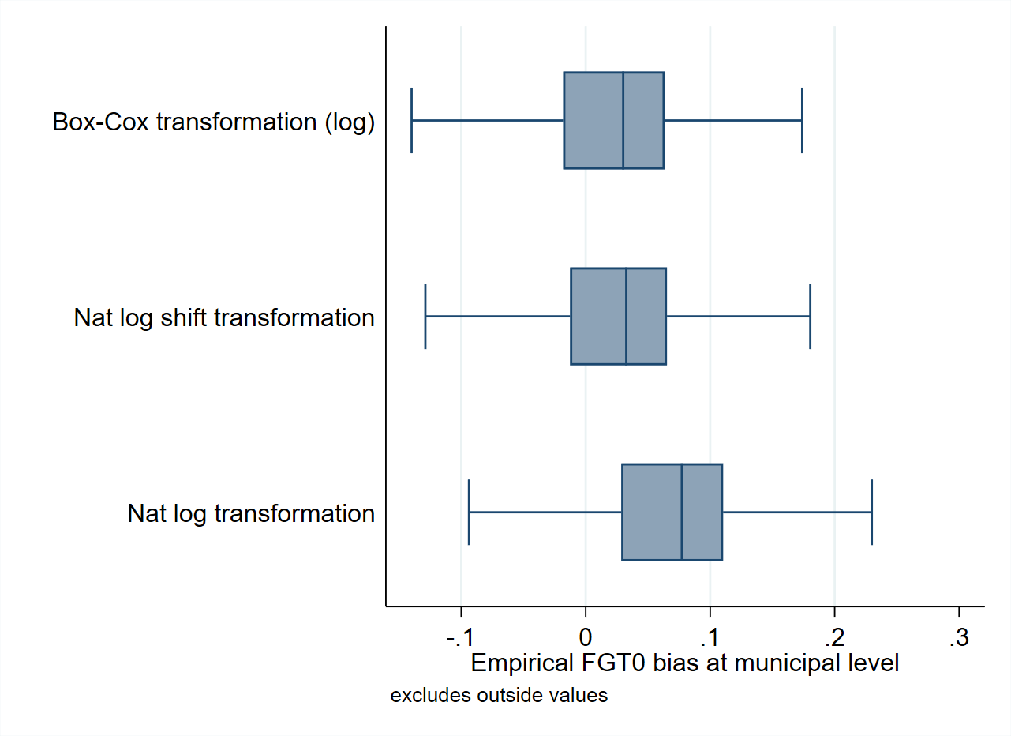
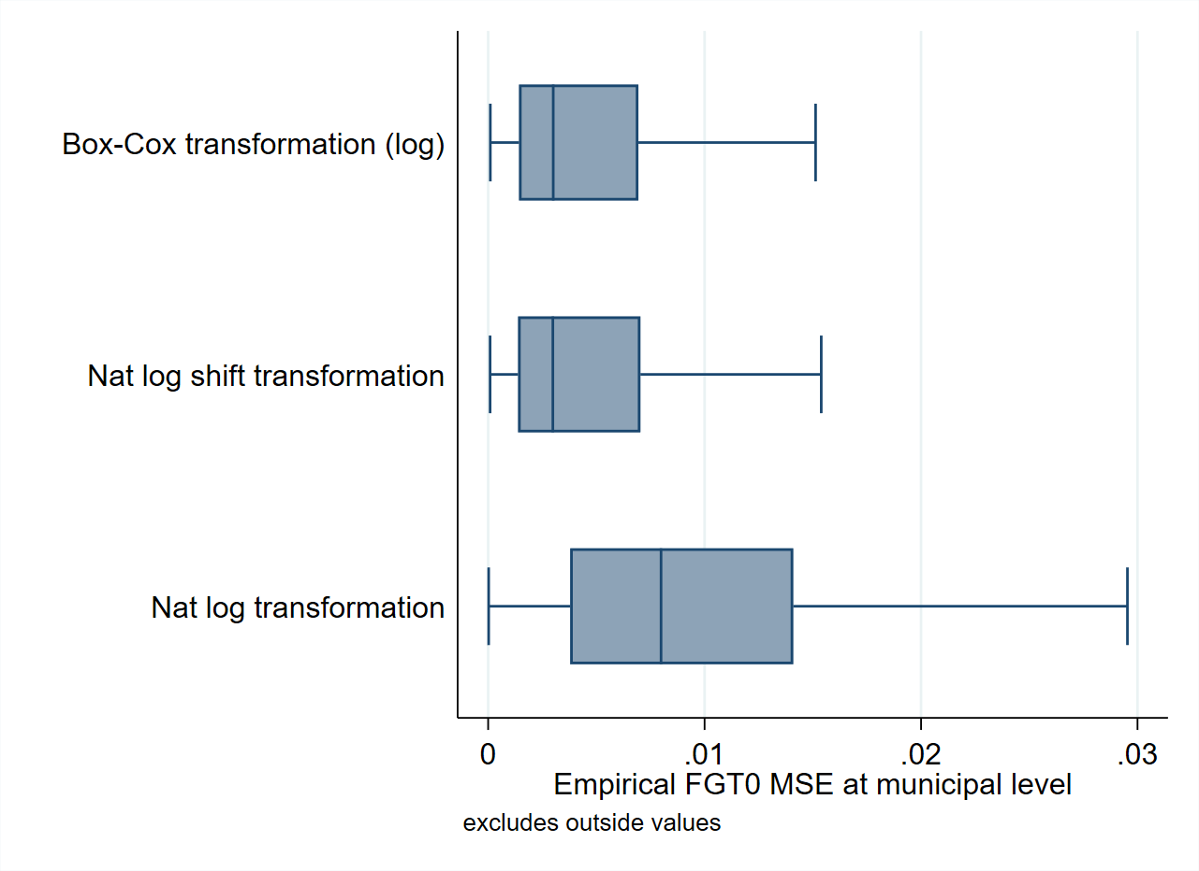


Transformation is necessary to achieve an approximately normal distribution
Nat. log
Box-Cox of Nat. log
Log shift
Bias ($CEB_{a}$)
MSE ($CEB_{a}$)
Notes:
-

Slide 10
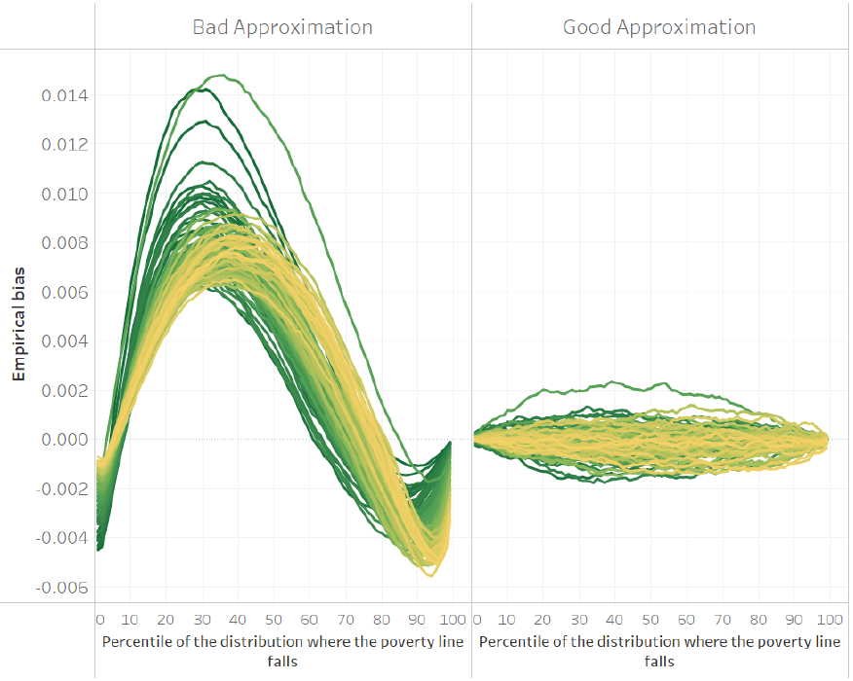
Transformation is necessary to achieve an approximately normal distribution
The implemented SAE methodology relies on approximating as closely as possible the welfare distribution
A model that that approximates the welfare distribution poorly may yield a decent estimate for a given poverty line, yet when judged at a different poverty line the method may completely fail
You can see this in the figure on the left.
A model where the model’s assumptions are imperfectly met may lead to the far-left figure. It will approximate values at certain thresholds but will do a poor job at others.
The model with good approximation has values which are adequate for every single area and threshold.
New “sae” codes allow for transformations beyond the natural log so that the assumptions can be better met.
The x-axis represents the percentile corresponding to a defined poverty line, the y-axis is the empirical bias. Each line corresponds to an area. See Corral et al. (2022) for details.
Notes:
-

Slide 11
Let’s now go to Stata to see the assumed model…
Open following do-file:
~01.dofiles/1.assumed_model.do

Slide 12
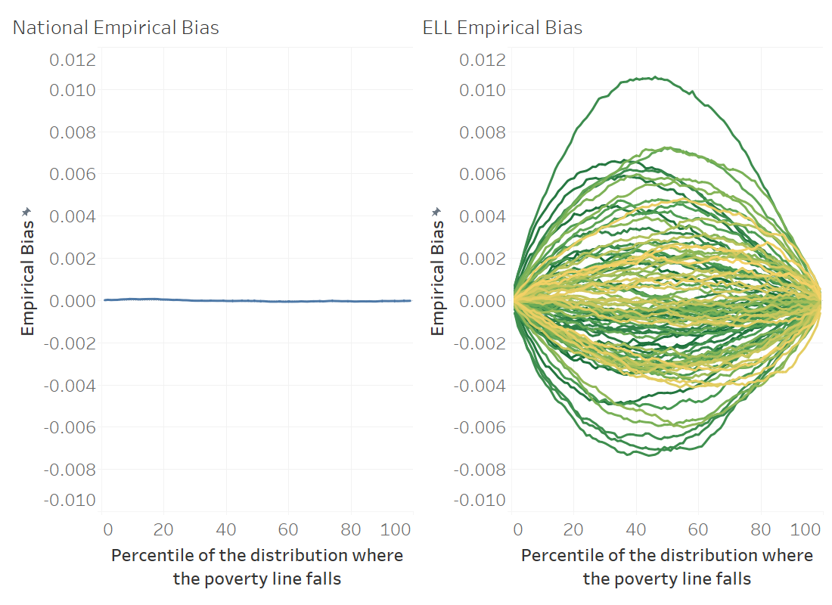
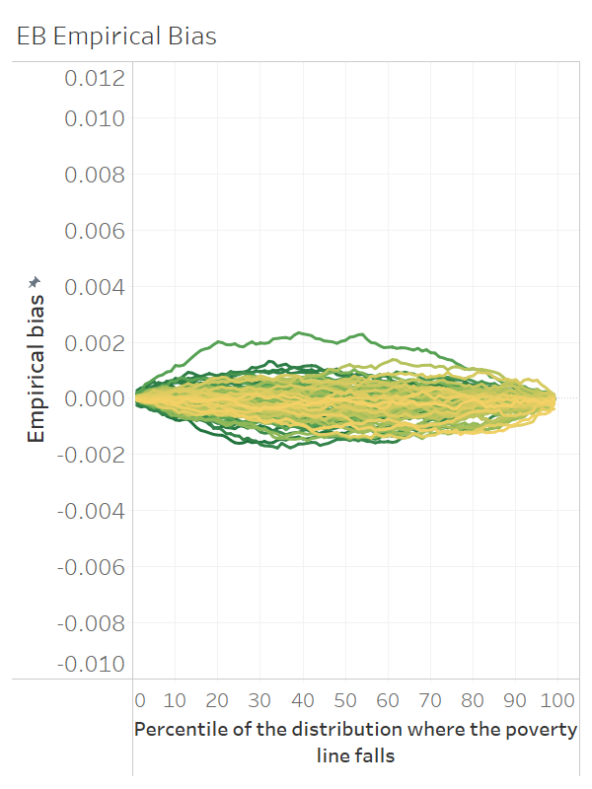
How do EB methods improve upon ELL methods?
EB ensures predictions of the dependent variable at the area level are aligned to the survey – best information at hand
At the national level (left) the ELL model works well and predicts poverty accurately across the welfare distribution
At the area level, because of the lack of EB, the method is less reliable and predictions for a given area show more bias than EB which leads to larger MSE
ELL and EB results from simulation where headcount poverty estimates are obtained under 99 different poverty lines covering the 99 percentiles of the simulated welfare distribution

Slide 13
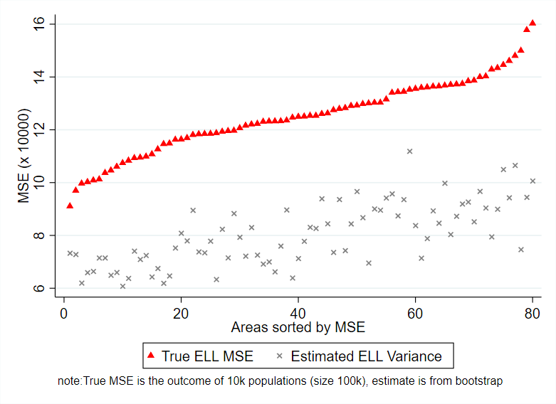
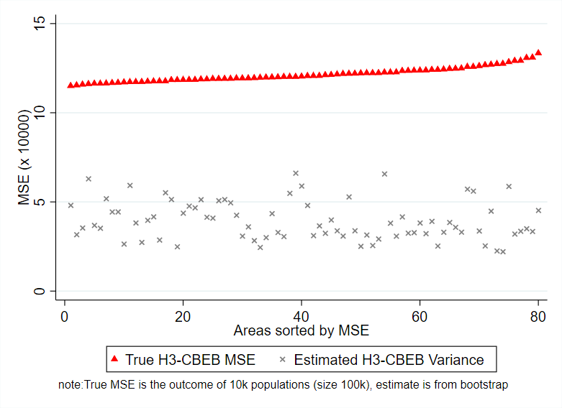
Also, due to the MI type of approach used in PovMap the noise of ELL and EB estimates was underestimated
See Corral, Molina, Nguyen (2021) for more details

Slide 14
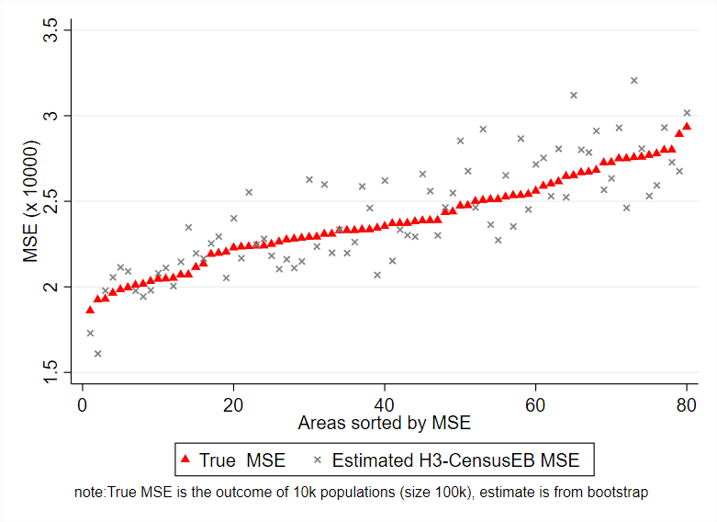
The MSE estimates from the parametric bootstrap (Gonzales-Manteiga et al. 2008) used for the CensusEB, EB, and Two-Fold models in the updated Stata sae package are aligned to the empirical MSE
See Corral, Molina, Nguyen (2021) for more details

Slide 15
Let’s now go to Stata and see how ELL differs from EB
Open the following do-file:
~01.dofiles/2.ELLvsEB.do

Slide 16
Molina and Rao (2010) through simulations show that EB methods are considerably less noisy than ELL. While Corral, Molina and Nguyen (2020) showed that ELL and the initial EB implementation in PovMap lag Molina and Rao’s EB method in terms of MSE
ELL’s MC implementation in PovMap was inspired on the multiple imputation (MI) literature
The goal in MI is not to minimize the MSE
When EB was implemented in PovMap a similar MI approach was attempted
This led to noisy and biased EB estimates
This is documented and corrected in Corral, Molina, and Nguyen (2021)
ELL and EB implemented in PovMap
Molina and Rao’s (2010) EB methods
Simulations from Molina and Rao (2010) conducted in Corral, Molina, Nguyen (2021)

Slide 17
Let’s now go to Stata and see how to validate a method through model-based simulations
Open the following do-file:
~01.dofiles/3.ModelBasedSim.do

Slide 18
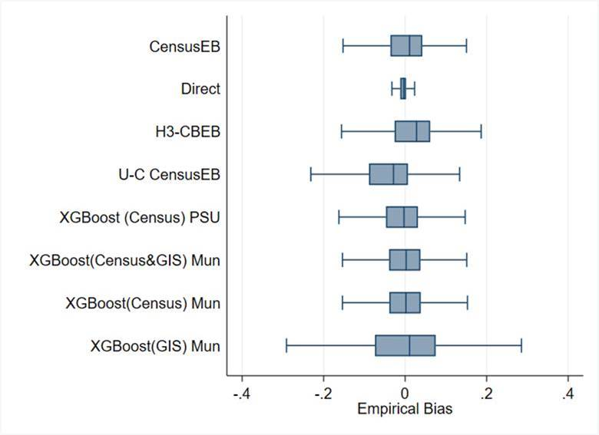
What about machine learning approaches? A validation with real world data...
FGT0 Bias (mun. level for 1,865 mun.)
Still work in progress… Working Paper coming before the end of the summer (2022)
All methods rely on census household and/or area aggregate covariates, unless stated otherwise
Notice the bias of the different methods
Direct estimates are the least biased
Notice how the box-plot for unit context models, those that model household level welfare using only area level covariates, is downward biased
XGboost yields good results. In some cases as good as censusEB
Results for XGboost from models using just GIS covariates are less stellar
Mexican intra-censal survey used as a census for design-based simulation based on 500 samples.
Notes:
-

Slide 19
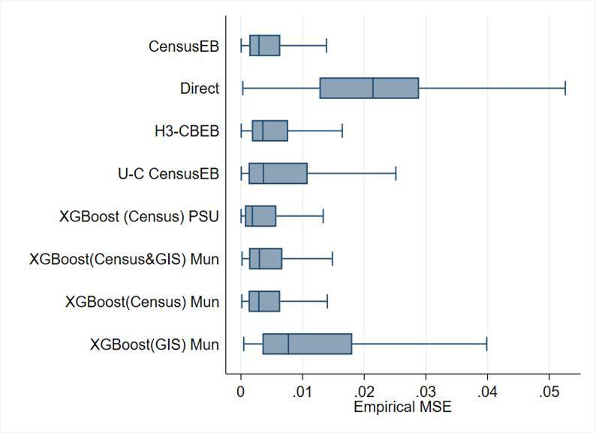
What about machine learning approaches? A validation with real world data...
Notice the MSE of the different methods
Direct estimates are the least biased, but noisiest
XGboost fit at the municipal level with just GIS covariates is the second noisiest
CensusEB, as expected, shows the smallest MSE, followed very closely by XGboost fit at the PSU level with just census aggregates
XGboost in this scenario outperforms unit-context models as those presented by (Masaki et al. 2020)
MSE (mun. level for 1,865 mun.)
Mexican intra-censal survey used as a census for design-based simulation based on 500 samples.
Notes:
-

Slide 20
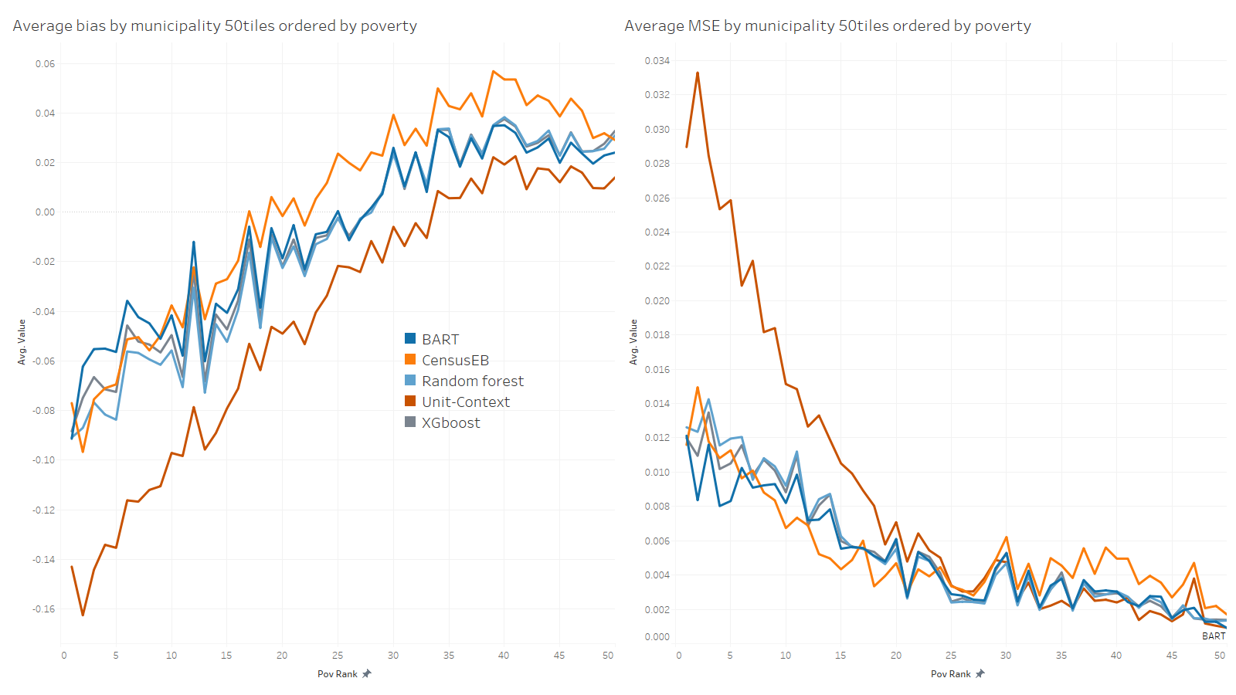
The bias and MSE are worse among poorer municipalities which may have considerable consequences for targeting
Mexican intra-censal survey used as a census for design-based simulation based on 500 samples.
Notes:
-

Slide 21
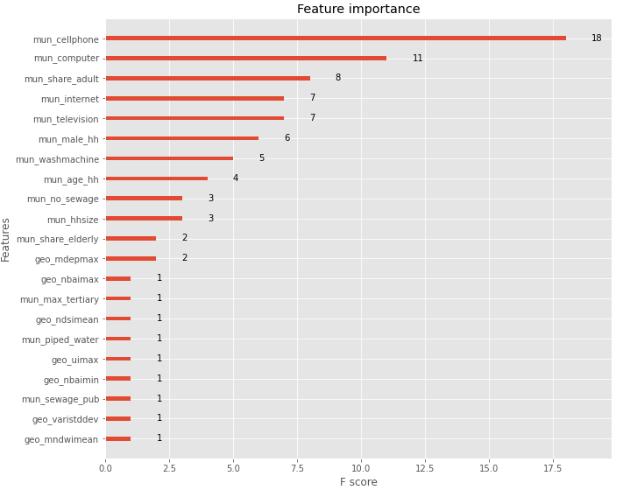
It all depends on the quality of the data!
The model works best with census data aggregates
When combining census aggregates and GIS covariates the method leans towards census aggregates
The empirical MSE of the gradient boosting models is smaller when only using census aggregates
In this scenario it suggests that census aggregates are better than GIS at explaining the variation of area level poverty
Covariates with mun_ prefix are derived from the census, geo_ are GIS covariates…
Notes:
evi: Enhanced Vegetation Index
ndvi: Normalized Difference Vegetation Index
ndbi: Normalized Difference Built-up Index
bu: Built-up Index
sr: Simple Ratio
arvi: Atmospherically Resistant Vegetation Index
ui: Urban Index
ibi: Index of biological integrity
ndwi: Normalized Difference Water Index
mndwi: Modified Normalized Difference Water Index
nbi: New Built-up Index
brba: Band Ratio for Built-up Area
nbai: Normalized Built-up Area Index
baei: Built-up Area Extraction Index
ndsi: Normalized Difference Snow Index
vari: Visible Atmospherically Resistant Index
savi: Soil Adjusted Vegetation Index
osavi: Optimized Soil Adjusted Vegetation Index
ndmi: Normalized Difference Moisture Index
mdea = Altitude from digital model
mdep = slope from digital model

Slide 22
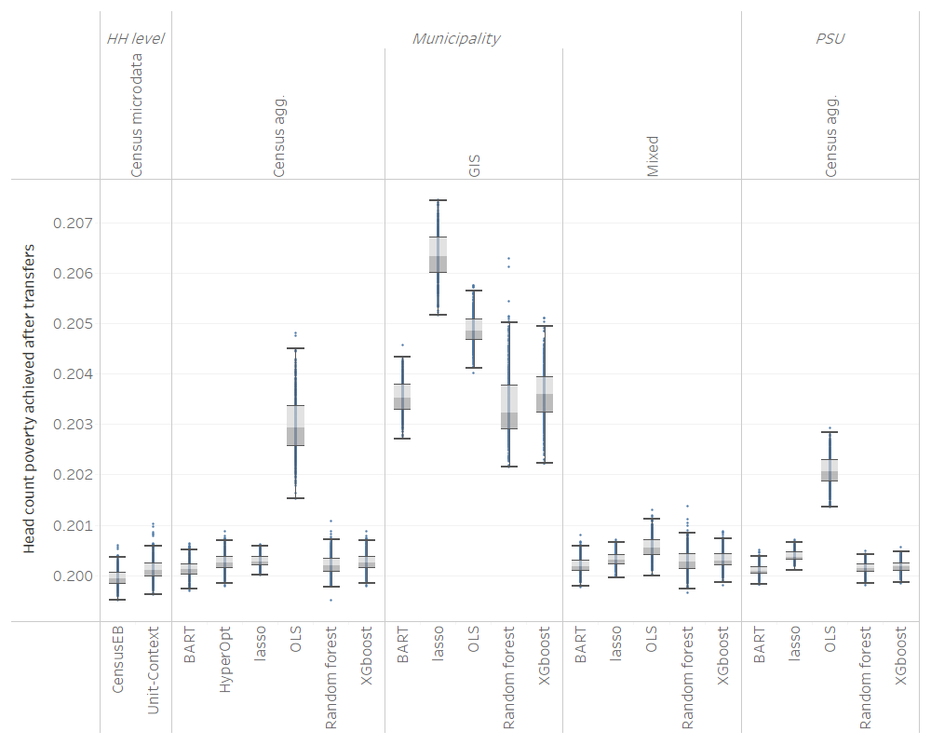
Does it matter for allocation of transfers?
Transfer budget is equal to the poverty gap of the population (census)
Original poverty is 25%
Using true poverty ranking we achieve poverty of 19.9% by giving all in the poorest areas the same transfer amount (budget/total number of poor)
Some methods do a better job than others, but in the end, something is better than nothing!
Notes:
evi: Enhanced Vegetation Index
ndvi: Normalized Difference Vegetation Index
ndbi: Normalized Difference Built-up Index
bu: Built-up Index
sr: Simple Ratio
arvi: Atmospherically Resistant Vegetation Index
ui: Urban Index
ibi: Index of biological integrity
ndwi: Normalized Difference Water Index
mndwi: Modified Normalized Difference Water Index
nbi: New Built-up Index
brba: Band Ratio for Built-up Area
nbai: Normalized Built-up Area Index
baei: Built-up Area Extraction Index
ndsi: Normalized Difference Snow Index
vari: Visible Atmospherically Resistant Index
savi: Soil Adjusted Vegetation Index
osavi: Optimized Soil Adjusted Vegetation Index
ndmi: Normalized Difference Moisture Index
mdea = Altitude from digital model
mdep = slope from digital model

